Slide 1

Discord Bot Workshop in C#
Brandon Tiev

Slide 2



What is a REST API?
API stands for application programming interface and a REST API is designed with a representational state transfer architectural style.
Interacts with a database via HTTP requests. Types of requests such as GET, POST, PUT and DELETE requests are used by the API to modify or retrieve data from the database.
fGet Account Info
GET Request
Now I have your social security number
Your social security number

Slide 3
Time to make the bot! Let’s code the startup first.
Resource Links:

Slide 4
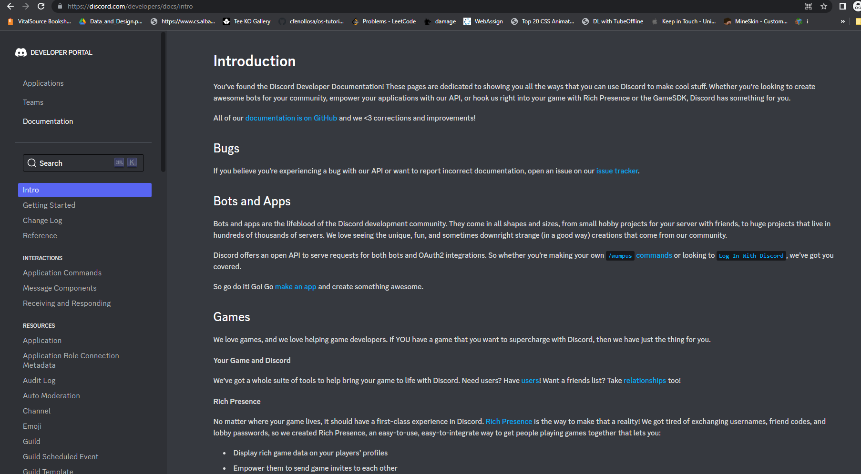
Let’s create an application!
https://discord.com/developers/docs/intro

Slide 5
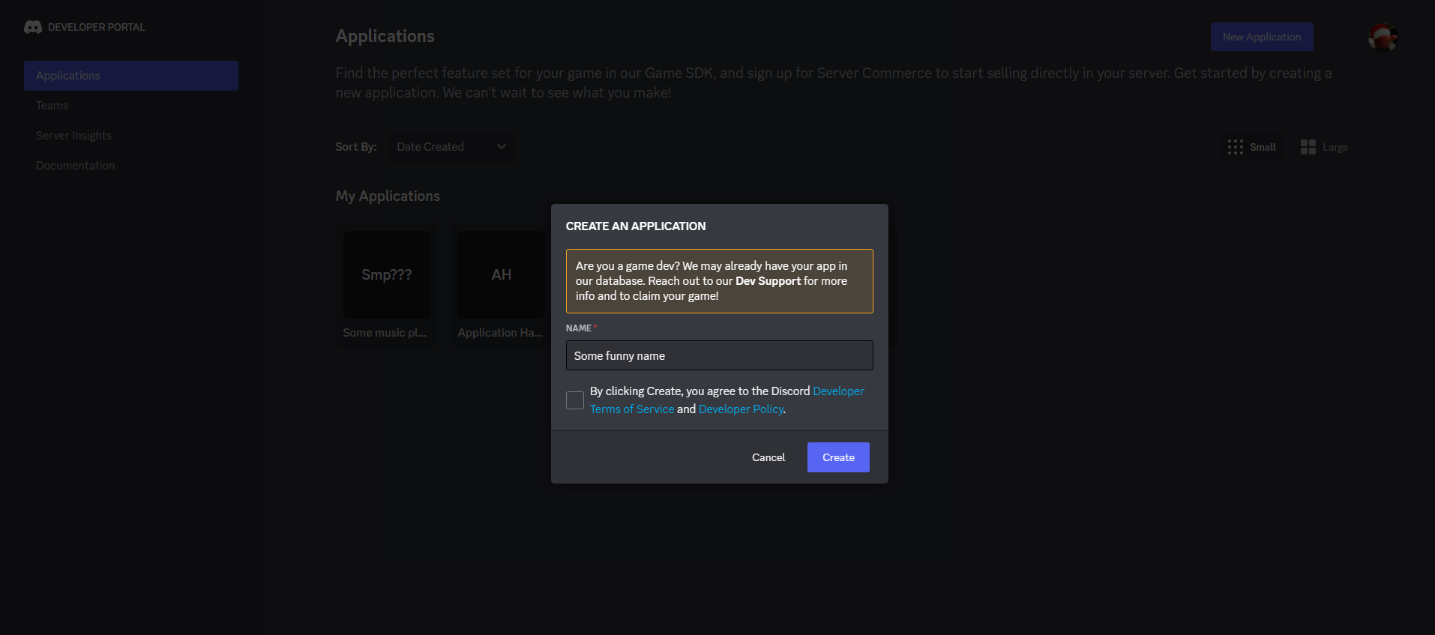
Creating the App
Create App
Bot name
And maybe check that box
Finalize

Slide 6
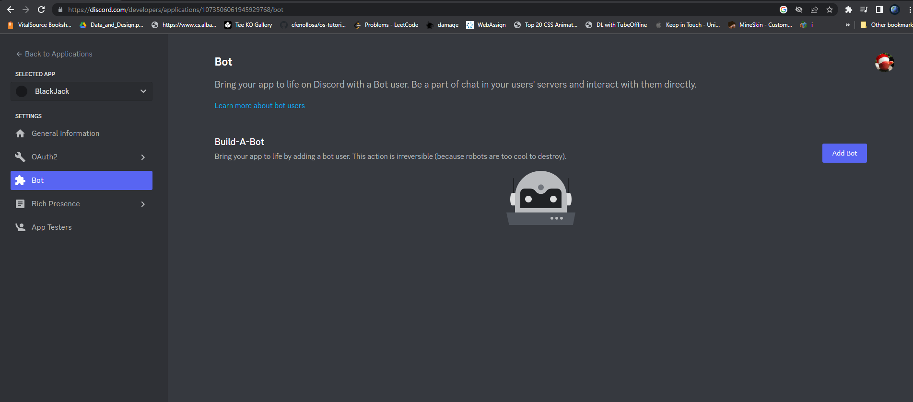
Make the bot

Slide 7
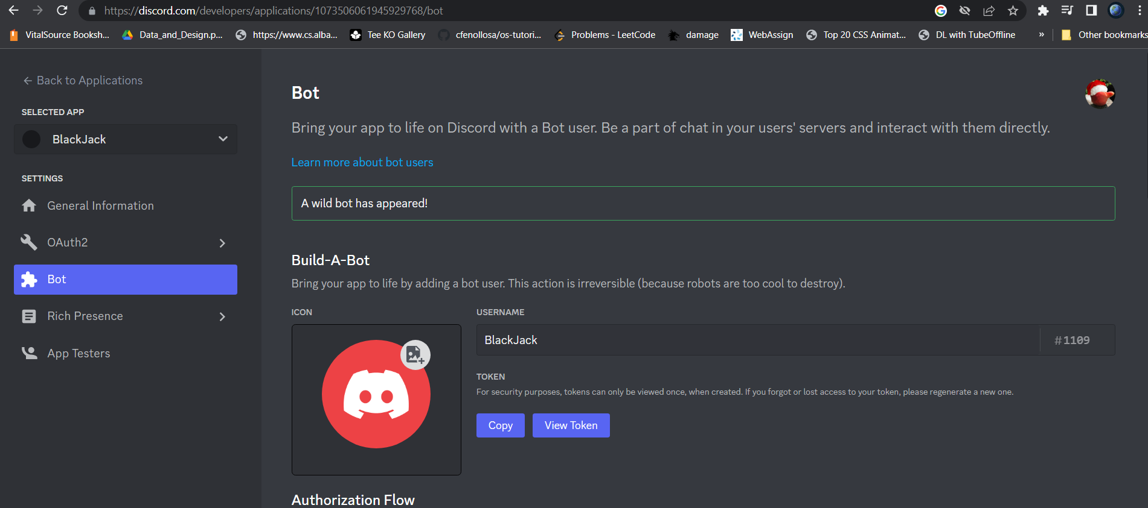
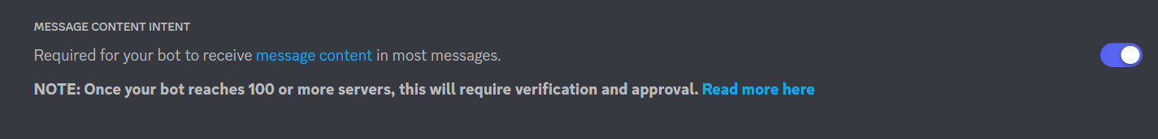
Retrieve the token Make sure that you save this token somewhere, you will not be able to see it again unless you reset it.
Copy token, no need to reveal
Ensure Message Intent is enabled

Slide 8
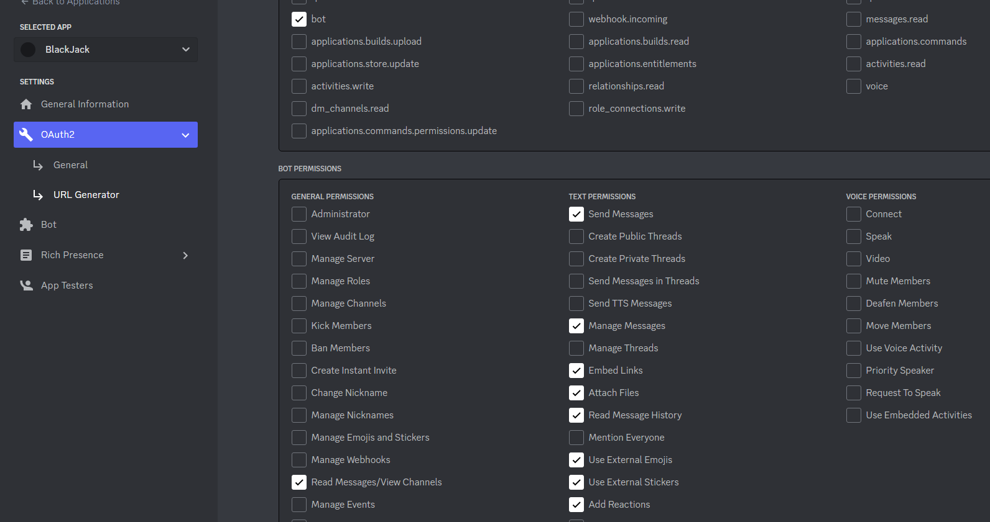
Invite your bot to a server
Select Bot
Select Permissions
Read Message/View Channels
Send Messages
Manage Messages
Embed Links
Attach Files
Read Message History
Use External Emojis
Use External Stickers
Add Reactions

Slide 9
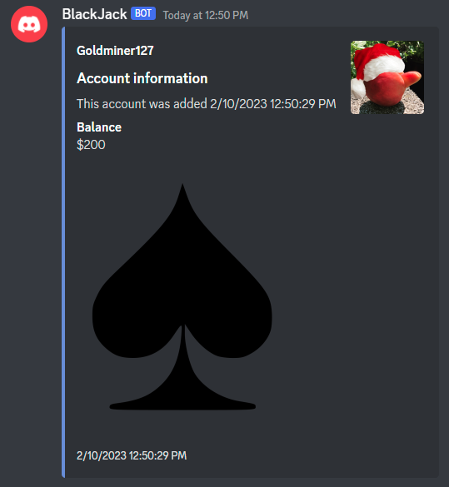
Discord Embeds
All properties
Author
Color
Description
Fields
Footer
Image
Provider
Thumbnail
Timestamp
Title
Type
Url
Video
Author
Title
Description
Field
Thumbnail
Image
Color
Footer

Slide 10
Interactivity
Allows users to interact with the discord bot while a command is in the middle of execution.
Used to respond to user’s responses
Used to detect emoji reactions
Used to detect message components
This workshop will use interactivity to respond with an action choice in BlackJack.

